Slide 1
Image content based classification of
vacation/ tourism related images
16-074

Slide 2

Welcome
Image content based classification of vacation/ tourism related images is a system which classifies images and automatically categorize them based on the image content.

Slide 3
Existing Products
Only identify objects
Almost all are still under research
Accuracy varies for each and every research still under 80%
limited to some specific area of images and objects

Slide 4
Research problem
Even though some algorithms have been developed to identify objects in an image, and even some to identify multiple objects in an image to an extent, they are not capable of interpreting the inter relation between the objects in the images, the context of the image in relation to the objects in the image and thereby wholistically understand the image, or in other words what the picture is about as an overview.

Slide 5
Main Objectives
upload an image or a set of unclassified images such as beaches, sunsets, waterfalls, landscapes, mountains etc.. and the application should output a classified list of images accurately grouping each image into broader category they belong to.
The user should be able to get a list of objects identified from the image ,a detailed description of the image and any other assumptions the program can come to from the image in addition to the main classifying classes.
the application will be limited to a limited set of classes such as beaches, sunsets, waterfalls, landscapes, mountains etc

Slide 6
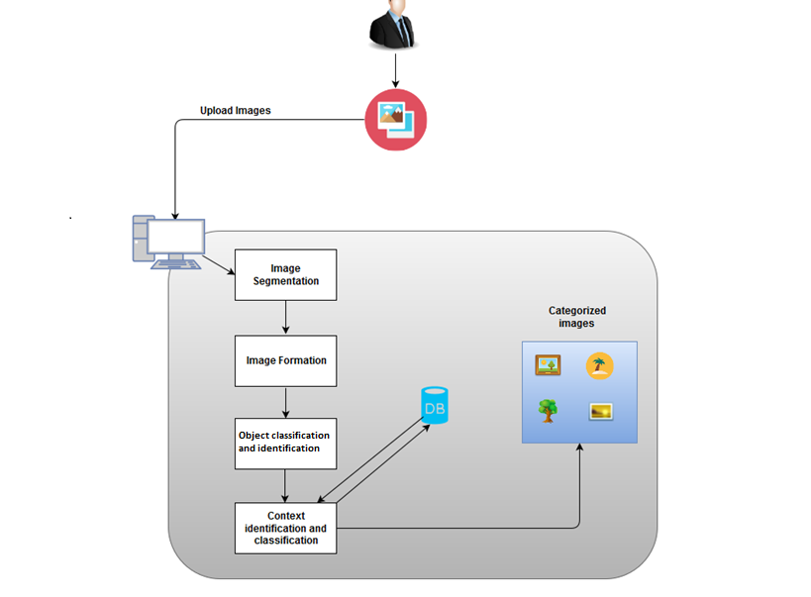
System Diagram

Slide 7
Methodology

Slide 8
Image segmentation
Image segmentation is a process of dividing an image into multiple parts or multiple regions.
There are two major techniques used in image segmentation
Edge based segmentation
Region based segmentation

Slide 9
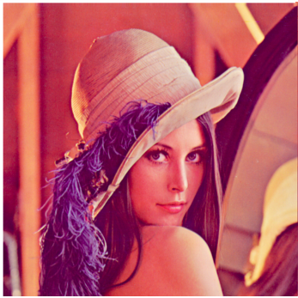
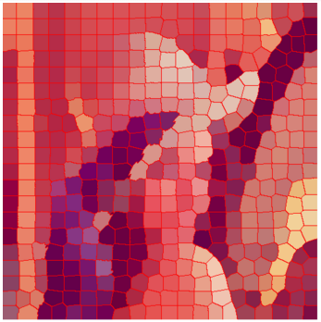
Image segmentation contd...
Source image segmented image

Slide 10
Edge based segmentation
Methods in edge based segmentation
thresholding methods
k-means clustering
histogram based methods etc.
2) Region based segmentation
Methods in region based segmentation
split-and-merge

Slide 11
Research done in segmentation
Linda G. Shapiro and George C. Stockman (2001): “Computer Vision”, pp 279-325, New Jersey, Prentice-Hall, ISBN 0-13-030796-3
Toru Tamaki, Tsuyoshi Yamamura and Noboru Ohnishi: “Image segmentation and object extraction based on geometric features of regions”,Part of IS&T/SPIE Conf. on VCIP'99, SPIE Vol.3653, Part Two, pp.937{945 (1999 1)

Slide 12
Image segmentation contd...
Most of the researches have used edge based segmentation technique because of the simplicity of it.
Another algorithm used for image segmentation is the popular random forest algorithm.

Slide 13
Random Forest Algorithm
A random forest is multi-way classiﬁer consists of a number of trees.
Each tree is using some form of randomization.
The leaf nodes are labeled by estimate of the distribution over the image classes.

Slide 14
Each internal node contains a test that splits the data to be classiﬁed.
Then sending each pixel through every tree and aggregating the leaf distributions.
Using this method the pixels can be grouped into superpixels and segments of the image can be formed.

Slide 15
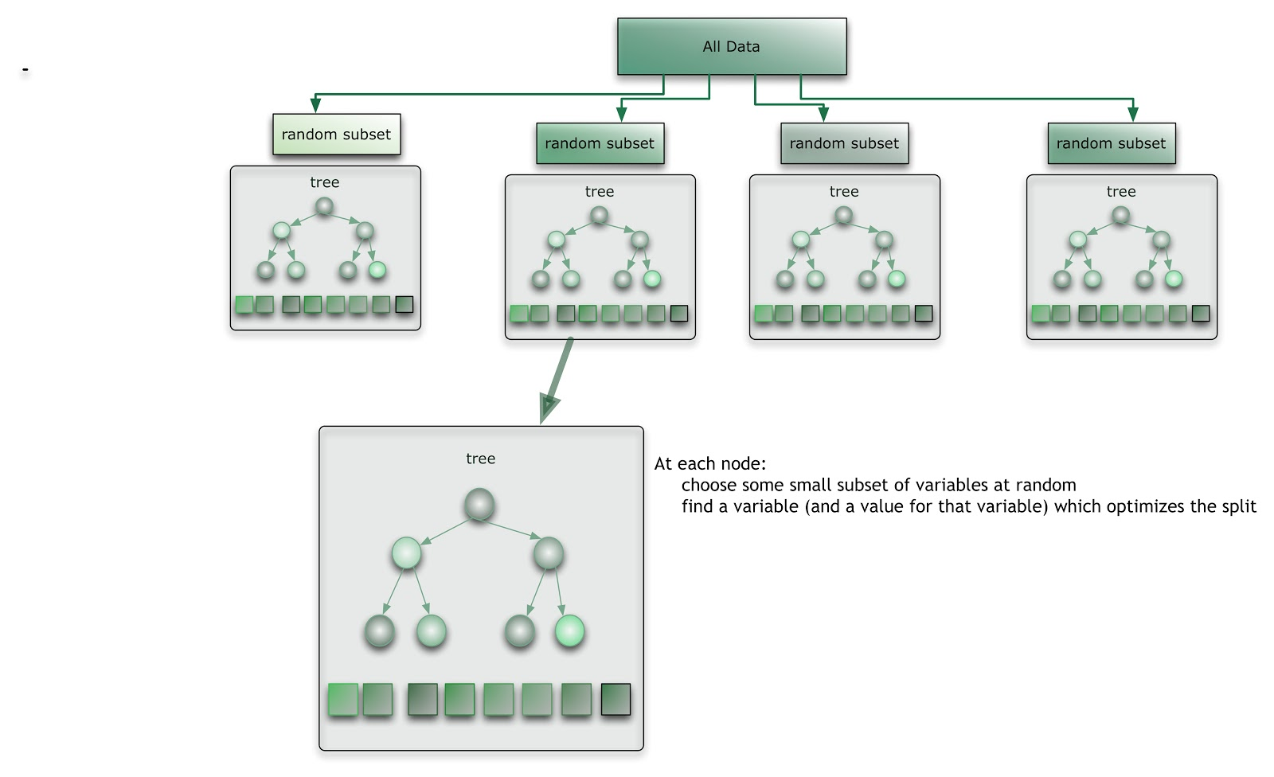
figure represents the source image which needs to be segmented. The other image represents the segmented image of the above image. The second image clearly shows the frames separately.

Slide 17
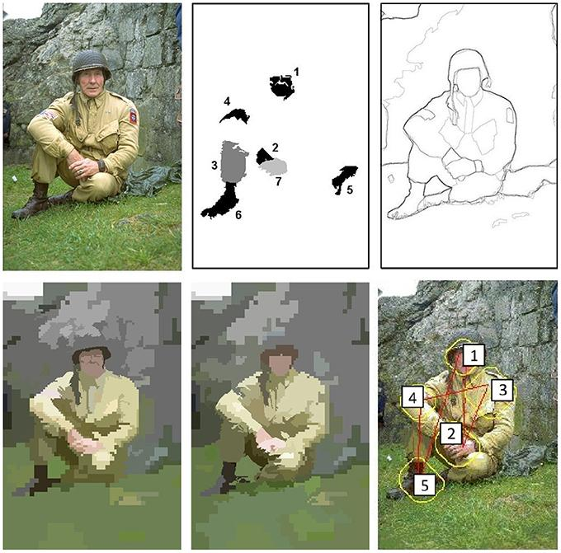
Object formation
Object formation is used after segmentation to identify the similar regions and their surrounding regions and group them semantically in order to identify objects clearly

Slide 18
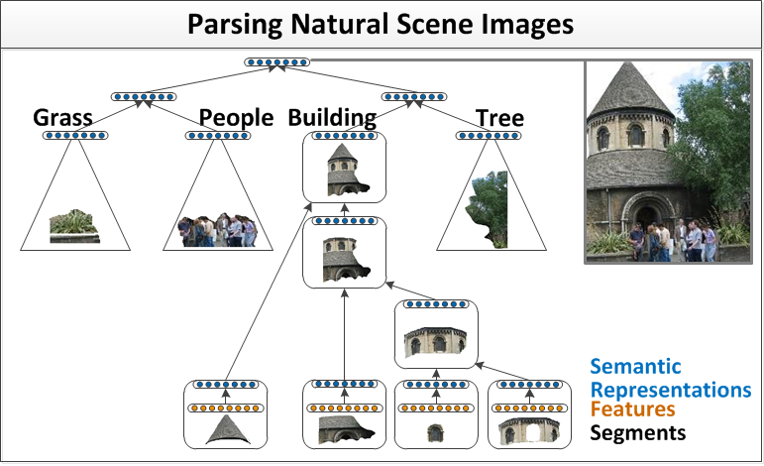
Formation contd...
Identify the similar regions and their surrounding regions and group them in order to identify objects clearly.

Slide 19
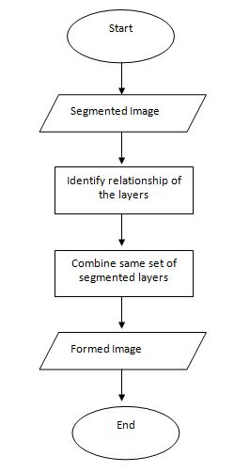

Slide 20
Formation contd...
Use a Neural Network to group the small segmented regions into a semantic space.
Then the segments with the same semantic class are merged to form larger identifiable regions such as sky, road, ocean,buildings etc.

Slide 21
Object classification and identification
Object identification and classification is another important part in image classification
used to identifying objects in an image.
Two common pattern recognition algorithms.
Appearance based recognition -
Changes in color , viewing direction , shape
Feature based recognition -
Corners , linear edges

Slide 22
Research done in this area
R. Socher, "Recursive deep learning for natural language processing and computer vision" 2014.
Howard, A. G., "Some Improvements on Deep Convolutional Neural Network Based Image Classification", arXiv preprint arXiv:1312.5402, 2013.
Krizhevsky, A., Sutskever I., and Hinton, G., "Imagenet classification with deep convolutional neural networks", Advances in neural information processing systems, 2012.

Slide 23
Object classification and identification Contd...
Machine learning techniques can be used to identify objects
first system is trained with a set of labeled training images
Then the system will be able to identify input objects

Slide 24
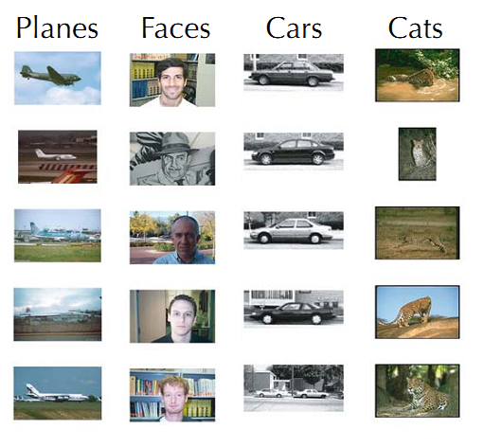
some sample test images which is used to train the neural network.
There are multiple images for one object.

Slide 25


Input image1
Plane
Input image2
Car
Trained system
Objects formed in previous phase

Slide 27
Image Context identification and classification
Important part of the research
wholistically tries to understand the image
identify the interrelationships between objects in an image

Slide 28
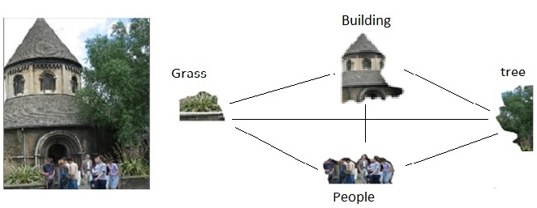
Image Context identification and classification
Image of a building

Slide 29
Image Context identification and classification
Using Recursive Neural Network to assess the semantic relationship between objects
provides an added level of accuracy to the system
semantically decides the category the image belongs to

Slide 30
Marketability - Business value
The final product can be marketed as a service
Any web application can use this service to categorize a given group of images

Slide 31
Thank you!

